Slide 1
Revision Theory for Stretegic Interaction
Riccardo Bruni
Università di Firenze
Dept. of Philosophy
Giacomo Sillari
LUISS Guido Carli, Rome
Dept. of Political Science
Bayes-by-the-Sea, Ancona 14 settembre 2018

Slide 2
Circular Concepts
Strategic Rationality
Strict Games
Quasi-strict Games
Proper Games
Non-strict Games

Slide 3
Circular Concepts
Circular Predicate:

Slide 4
Circular Concepts
Circular Predicate:
Hypothesis:

Slide 5
Circular Concepts
Circular Predicate:
Hypothesis:
Revision Step:

Slide 6
Circular Concepts
Circular Predicate:
Hypothesis:
Revision Step:
Regularities:

Slide 7
Strategic Rationality

Slide 8
Strategic Rationality
Players A and B maximize their payoffs

Slide 9
Strategic Rationality
Players A and B maximize their payoffs
An action is rational if it is payoff-maximizing

Slide 10
Strategic Rationality
Players A and B maximize their payoffs
An action is rational if it is payoff-maximizing
In order to determine what’s rational for A, one needs to know what’s rational for B, and viceversa

Slide 11
Strategic Rationality
Players A and B maximize their payoffs
An action is rational if it is payoff-maximizing
In order to determine what’s rational for A, one needs to know what’s rational for B, and viceversa

Slide 12
Strategic Rationality
Players A and B maximize their payoffs
An action is rational if it is payoff-maximizing
In order to determine what’s rational for A, one needs to know what’s rational for B, and viceversa
USE CIRCULAR PREDICATES

Slide 13
Strategic Rationality
Eg, to say that a₁ is rational for player A is to say (φ₁) that
Either b₁ is rational and u_{A}(a₁b₁)>u_{A}(a₂b₁)
Or b₂ is rational and u_{A}(a₁b₂)>u_{A}(a₂b₂)
Thus, we can define a circular rationality predicate R(x) as:
R(x) =_{def} ((x = a₁ & (φ₁)) v (x = a₂ & (φ₂)) v (x = b₁ & (ψ₁)) v (x = b₂ & (ψ₂)))

Slide 14
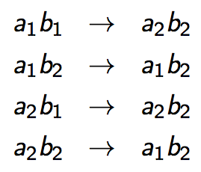
Strategic Rationality

Slide 15
Strategic Rationality

Slide 16
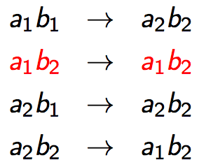
Strategic Rationality

Slide 17
Strategic Rationality
FIX-POINT = NASH

Slide 18
Quasi-strict Games
The above only holds for strict Nash equilibria in strict games
If a player has a weak best reply, then the revision function halts.

Slide 19
Quasi-strict Games
Under the hypothesis that a₁ is rational, player B has two weak br, b₂ and b₃.
How to “break the tie” between b₂ and b₃?
Were player 1 to play irrationally (tremble), b₂ would be better than b₃
The revision process would not halt and the fix point corresponds to trembling-hand perfect equilubrium

Slide 20
Quasi-strict Games
How to formalize this intuition?
Take the rationality predicate introduced before: we will now need to modify the φ and ψ formulas.
R₂(x) =_{def} ((x = a₁ & (φ’₁)) v
(x = a₂ & (φ’₂)) v
(x = b₁ & (ψ’₁)) v
(x = b₂ & (ψ’₂)) v
(x = b₃ & (ψ’₃)))

Slide 21
Quasi-strict Games
2. Take Strict₁^{A} to be the formula
(in English: player B plays rationally and a₁ is A’s best reply)

Slide 22
Quasi-strict Games
3. Now, define a formula to deal with cases in which players have a weak best reply and we want the revision function to choose according to the trembling hand intuition; define Weak^{A}_{(1,1)} as:
And similarly define Weak^{A}_{(1,2)} , Weak^{A}_{(1,3)} , Weak^{A}_{(2,i)} , with i =1,2,3; and corresponding formulas for B
Notes:
a1 is weak br under assumption that b1 is rational

Slide 23
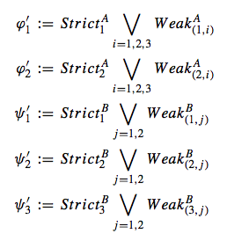
Quasi-strict Games
4. Now we can define the φ’ and ψ’ formulas to populate the rationality predicate:

Slide 24
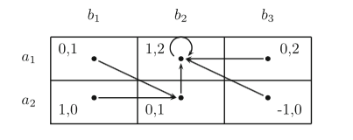
Quasi-strict Games

Slide 25
Proper Games
In this case player A’s tremble does not help the revision process as
b₁ is br in case of a₃ but
b₂ is br in case of a₁.
But, if player A were to tremble, she’ll likely make a mistake towards the higher payoff (a₁)
Revision process does not halt and fix point now corresponds to proper equilibrium intuition

Slide 26
Proper Games
In this case player A’s tremble does not help the revision process as
b₁ is br in case of a₃ but
b₂ is br in case of a₁.
But, if player A were to tremble, she’ll likely make a mistake towards the higher payoff (a₁)
Revision process does not halt and fix point now corresponds to proper equilibrium intuition

Slide 27
Proper Games
Define adequate Prop^{I}_{(i,j)} formulas (for instance this is Prop^{B}_{(2,2)} for the game we are considering:
Define φ* and ψ* formulas to populate the rationality predicate…

Slide 28
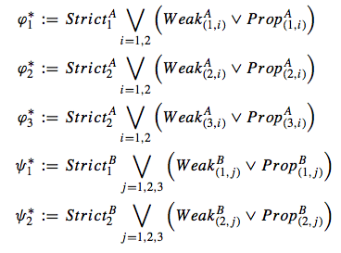
Proper Games
…as disjunctive formulas:

Slide 29
Non-strict Games
In this game both trembling-hand and properness criteria fail
If player A, for no particualr reason, thinks player B is more likely to tremble from b₁ to b₃ then she will choose a₁
introduce a lexicographic clause for the revision function based on the ordering of the action labels

Slide 30
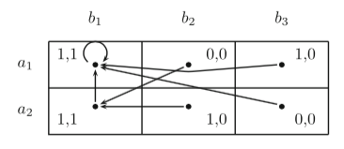
Non-strict Games
In this game both trembling-hand and properness criteria fail
If player A, for no particualr reason, thinks player B is more likely to tremble from b₁ to b₃ then she will choose a₁
introduce a lexicographic clause for the revision function based on the ordering of the action labels

Slide 31
More solution concepts
In strict games, fix point corresponds to Nash;
In quasi-strict games, fix point captures trembling-hand intuition;
In proper games, fix point captures properness intuition;
In non strict games, we can resort to a lexicographic ordering
In general, by suitably defining the rationality predicate, we can capture the solution concept we are interested in, eg. regret (risk and compensation)

Slide 32
Further work
Incorporating mixed strategies (e.g. Sack and van der Hoek Studia Logica 2014)
Thus, relating this work to dynamic epistemic logic (eg Baltag and Smets plausibility models)
Thank you!

